Slide 1
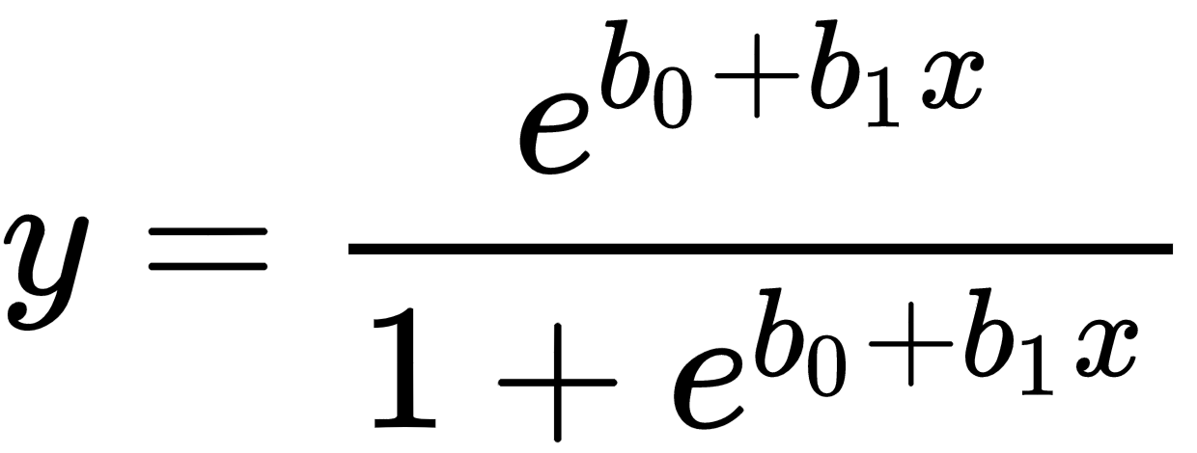

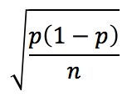
Inter-university Consortium for Political and Social Research
ICPSR: Inter-University Consortium for Political and Social Research
The data provided covers the years 2012 to 2017.
8th to 10th graders
“Monitoring the Future: A Continuing Study of American Youth (8th- and 10th-Grade Surveys),”
Presented by,
Joshua Laferriere
Preranareddy Ananth
Shubham Bhowate

Slide 2
Preliminary Division
The factors were already divided into the following categories
A. Drugs
B. Education.
C. Work and Leisure.
D. Gender/Sex Roles and Family.
E. Population Concerns.
F. Conservation, Materialism, Equity, etc.
G. Religion.
I. Social Change.
J. Social Problems.
L. Military.
M. Interpersonal Relationships.
O. Concern for Others.
P. Happiness.
Q. Other Personality Variables.
R. Background and School.
S. Deviant Behavior and Victimization.
T. Health habits and symptoms.

Slide 3
PROBLEM STATEMENT
The three questions which we intended to solve through this project are given below:
What factors influences being included in above or equal to median value of GPA? (B+)
What factors influence having a history of Gang Violence?
What factors influence lifetime presence of psychedelic drug use?

Slide 4
System Files
The system consists of 2 different main files.
Cleandatacode.R
Derives final.csv which stores cross-validated thresholds,
does factor reduction.
saveCSVs.R
Best subset
Class balancing
ROC
Population model to population data
Monte Carlo model to population data
Monte Carlo model to Monte Carlo data
Check VIF for collinearity
Confusion Matrix
Correlation Plots

Slide 5
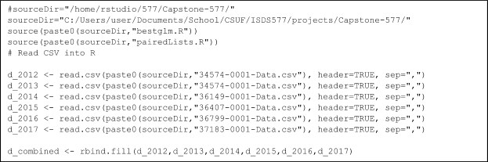
DATA CLEANING
Rows: 182338
[1] "min one:" "0.014"
[1] "min zero:" "0.043"
N/A values coded as -8 and -9 and simply N/A values
Cleaned by approaching two columns at a time
Numerical and Categorical values
Focus on behavioral, habitual and environmental factors.

Slide 6
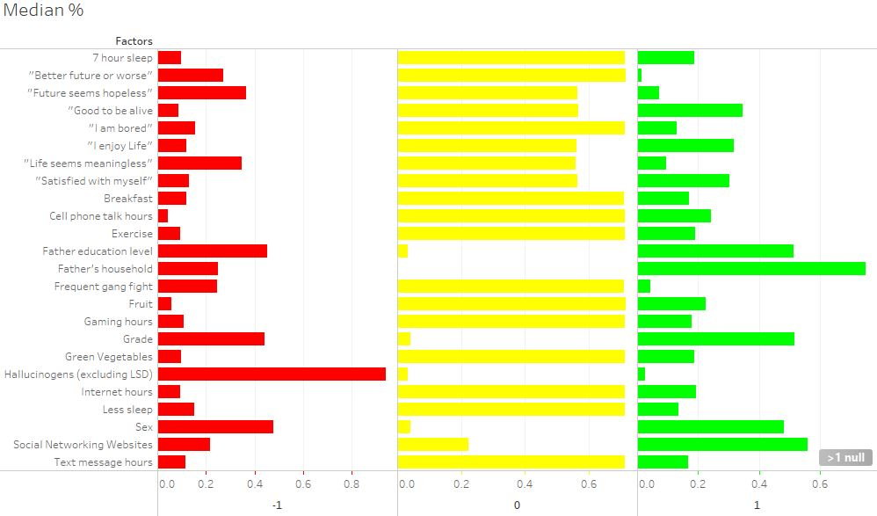
NA’s by Class per Factor
Notes:
To address the issue with NA’s we took two approaches. Rather than applying it to the entire data frame d_combined (which results in no records!) or excluding columns with excessive NAs. Our approach was to deal with NA’s at the last possible moment at the smallest possible level which was when we aggregated the columns together. After generating pairedLists.R we modified the algorithm to work with only 2 columns at a time. This was the juncture at when the records are dropped.
reseedboth.R calls up a factor and cleans it of na’s when it is joined with 2 other factors (y and another paired x).
reseedboth.R is called in close conjunction with redrawTrain.R and redrawTest.R to close the loop out and keep the function call close to data use to avoid messy manipulations inbetween.

Slide 7
Input files
Y’s
gpalist.txt
psyDFilterList.txt
gangfight.txt
The columns represented in these input files represent (see next slide for appended x’s)
factor id
conversion profile
description
category flag (no longer used aside from excluding 8’s as non-response terms and 0 as response and all else as x’s)
V7221,2,"R HS GRADE/D=1",0
V8517,1,"FRQ GANG FIGHT",8
V7118,1,"#X PSYD/LIFETIME",8

Slide 8
Template of X’s
V7202,0,"R'S SEX",2
V7206,0,"R'S HSHLD FATHER",2
V7215,2,"FATHR EDUC LEVEL",2
V7551,2,"#HR/W INTERNET S",3
V7552,2,"DALY WEB FACEBK",3
V7553,2,"#HR GAMING",3
V7562,2,"#HR TEXT",7
V7563,2,"#HR TALK CELL",7
V8526,3,"OFTN EAT BRKFST",4
V8527,3,"OFTN EAT GN VEG",4
V8528,3,"OFTN EAT FRUIT",4
V8529,3,"OFTN EXERCISE",4
V8530,3,"OFTN 7HRS SLEEP",4
V8531,3,"OFTN SLEEP <SHLD",4
V8502,3,"LIFE MEANINGLESS",5
V8505,3,"I ENJOY LIFE",5
V8509,3,"FUTURE HOPELESS",5
V8512,3,"SATISFD W MYSELF",5
V8514,3,"GOOD TO BE ALIVE",6
V8536,3,"FUTR R LIFE WRSE",6
V8565,3,"I AM OFTEN BORED",6
Median’s
V7221,2,"R HS GRADE/D=1",0
Median: #7: B+ 95% conf interval confirmed
V7215,2,"FATHR EDUC LEVEL",0
#5: for college grad father, 95% conf confirmed
V7551,2,"#HR/W INTERNET S",0
#4: 3-5 Hours Internet #95% conf confirmed
V7552,2,"DALY WEB FACEBK",0
#5: 6-9 Hours Facebook # 95% conf confirmed
V7553,2,"#HR GAMING",0
#4 3-5 Hours Gaming # 95% conf confirmed
V7562,2,"#HR TEXT",0
#4 3-5 Hours Texting # 95% conf confirmed
V7563,2,"#HR TALK CELL",0
#2: <1 Hour talking on cell phone # 95% conf confirmed
Notes:
The following set of 21 factors serve as a template and are shared across each response term
This was based on findings of the correlation matrix

Slide 9
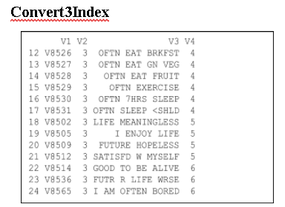
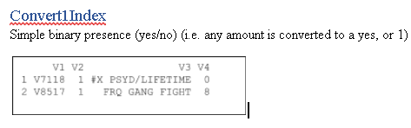
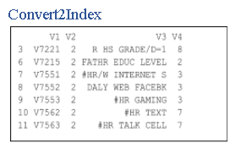
Data Cleaning: Conversion Profiles
convert1Index
Simple yes/no
convert2Index
Median based
One deciding constant set at loop iteration
medianDirection
controls operant condition: >= median or > median
convert3Index
split around a positive response (i.e. response was classed as 4+: “mostly” or higher).

Slide 10
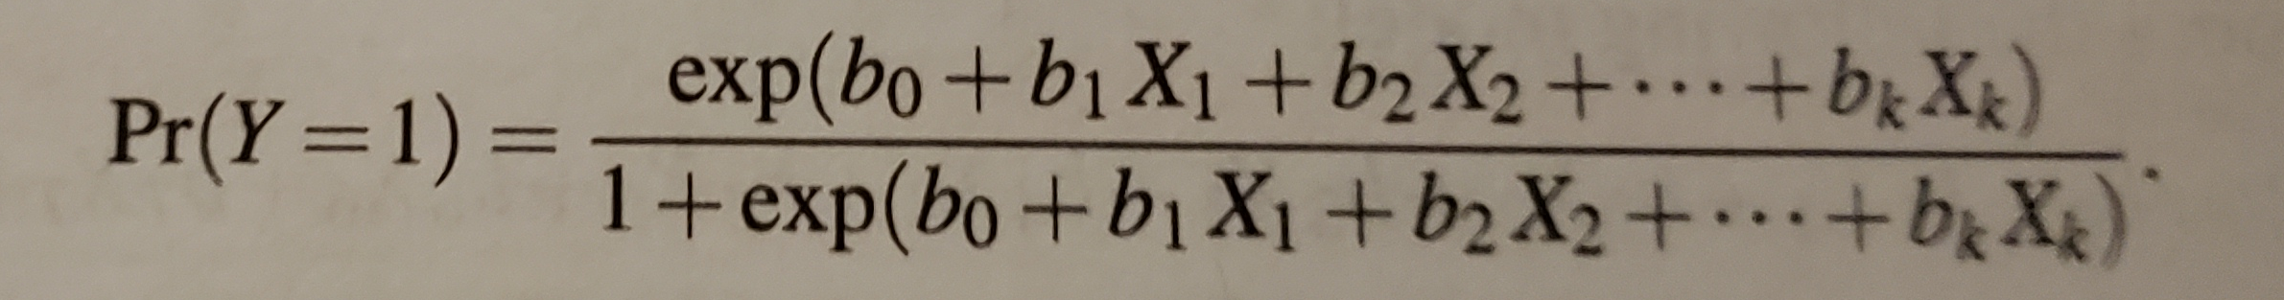
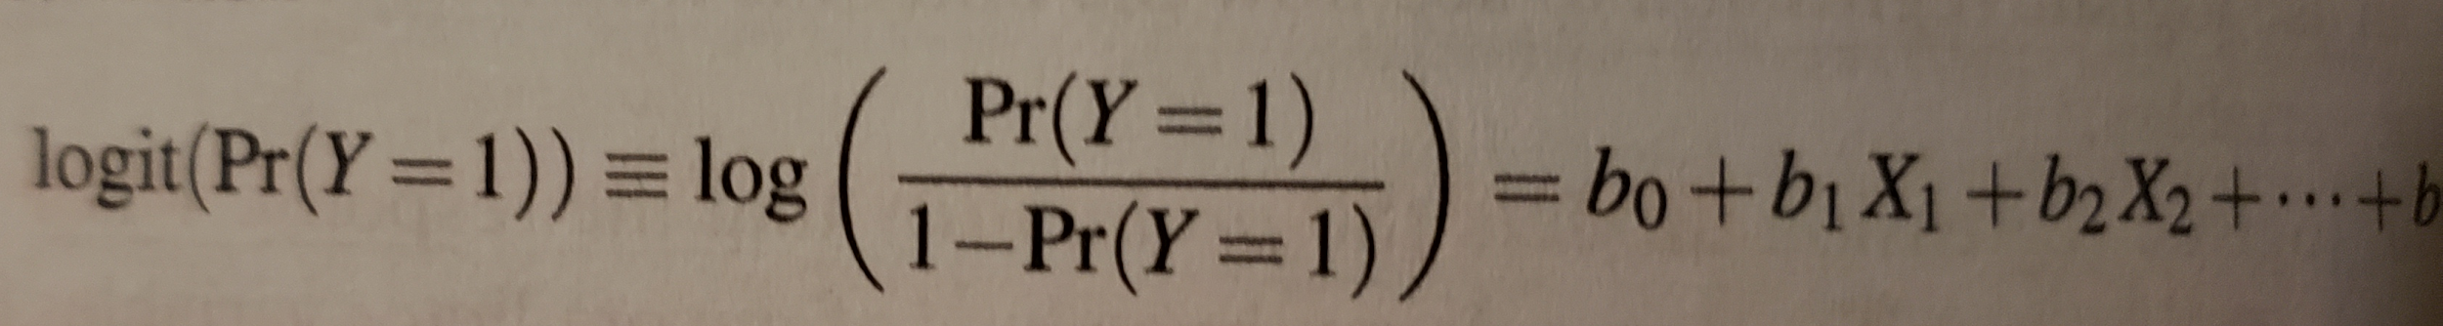
HYPOTHESIS
H0 sum(Coefficients) = 0
H1 sum(Coefficients) > 0
Find robust subset
We set to show that H1 is true by finding all significant terms
Notes:
The response Y is given as a logs and needs a logit transform applied before it is considered a probability.
as outputted by R after using cross validation and simulation to converge on a set using holdout analysis as well as monte carlo class balanced resampling prior to doing so.

Slide 11
Oversampling
Stratified resampling
Size of 0s = Size of 1’s
Sample size - deriving the minimum between 10% of the population of 0’s and 10% of the population of 1’s
Reloop factor - Dividing this minimum by the average of 10% of the population of 0’s and 10% of the population of 1’s.
Sample code is given for saveCSVs.R (vs cleandatacode.R’s version which utilizes 10% vs 25%).
avgCountHalved <- round(mean(length(input_ones[,1]),length(input_zeros[,1]))/2)
minFactor <- min(round(.25*length(input_ones[,1])),round(.25*length(input_zeros[,1])))
reloopFactor <- min(round(.25*length(input_ones[,1])),round(.25*length(input_zeros[,1])))/round(.25*avgCountHalved)

Slide 12
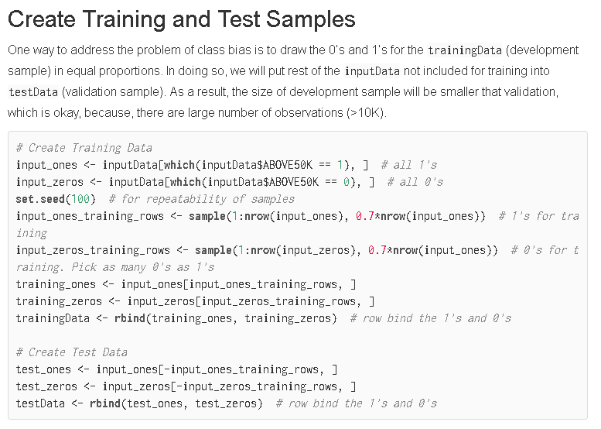
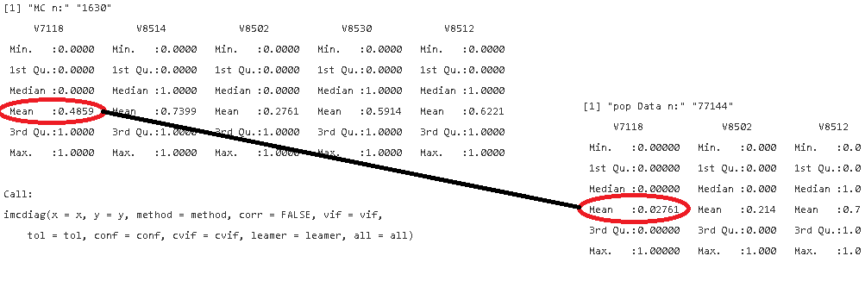
Monte Carlo
Class Balancing
We use stratified means to do predictor effect plots
Notes:
To achieve model robustness, we exploit measures of central tendency such as bifurcating around the median as well as deriving population means using stratified subsampling such as bootstrapping and monte carlo resampling.

Slide 13
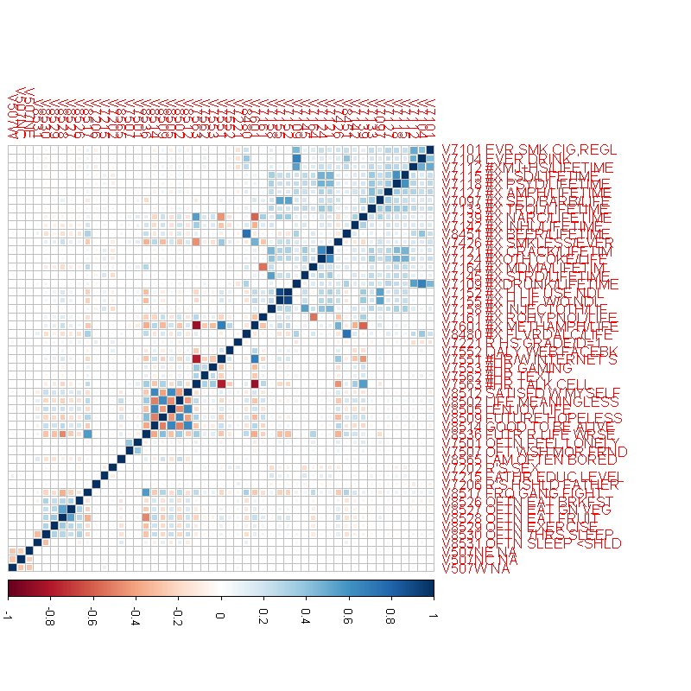
CORRELATION MATRIX
Grouping of relevant factors
V8512 - V8536 psychology
V8517 - V8531 health
V7501 - V7206 one-offs
V7551 - V7563 habits
V7501 and V7507 dropped because of having more than 75% N/As.
Multicollinearity check - Checked all pairwise X combinations, if they had greater correlation compared to the response term.
Notes:
V7101 to V8480 - substances
V8512 through V8546 - psychology
V8517 through V8531 - Health
V7551 through V7563 - habits
we dropped V7501 and V7507 for having more than 75% NA’s.

Slide 14
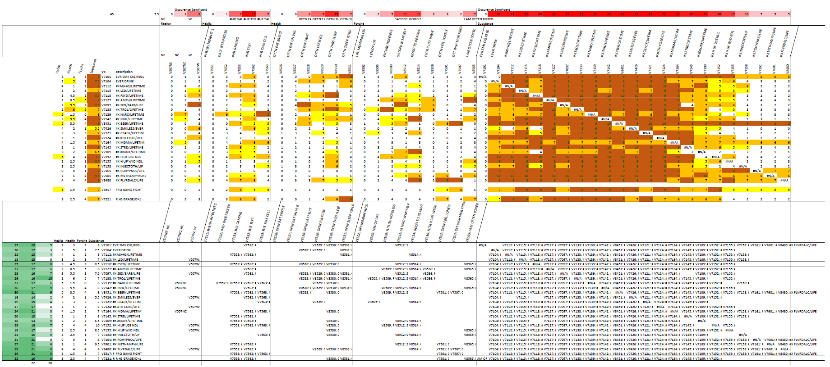
Early tabulation Algorithm: StepAIC
Setup data partitioning that utilized holdout for use with stepAIC, a full model regression iterator.
We tabulated the terms found significant each subsample pass.
We dropped StepAIC for BestGLM but before we did, we drew some inferences based on these early cross tabulation results
Shifted substance focus to Psychedelic drug use
Expanded Y’s to include GPA and Gang Fights
Dropped V507NE (School region - Northeast), V507NC (School region - Northcentral) and V507W (School region - Northwest) as found not relevant
By category, factors associated the most with drug use
“Texting”
“Sleep”
“Satisfaction with myself”
“Feeling good to be alive”
Notes:
Our plan began to focus around finding a filtering algorithm (stepAIC or bestGLM) and let the tabulation do the filtering for us and view the results after a few runs at various settings. We initially tried stepAIC but realized it wasn’t using exhaustive search spaces and would often result in nothing to report, so we switched to a modified bestglm.

Slide 15
Data Partitioning,
Loops
Partitioning & Sampling Files
newDF.R
reseedboth.R
reseedTest.R
reseedTrain.R
MCResampleTest.R
MCResampleTrain.R
redrawTrain.R
redrawTest.R
pairedList
Key Features
Uses indexing
Drop’s na’s after pairing only 3 columns at a time (during reseedBoth.R) which allows us to test more columns and get to the root of the na issue at the smallest possible level and built up regression models from there.
NamesTVuses training partition (data.train)
NamesH uses holdout partition (data.test)
10 holdout set loops reset holdout (and non reset, i.e. pretrain) set partitions at 10% each
data.train and data.test draw from these two distinct partitions during resample loop
resample loops occur 3 x each holdoutset loop resampling 33%.
10x3= 30 loops tabulated
Notes:
Column pairing assumes one term will be significant by itself.
2 terms could pass through the algorithm, but the system is not properly setup to handle such occurances.
So in other words. The synergy between terms is not something that is captured by this system until saveCSVs.R

Slide 16
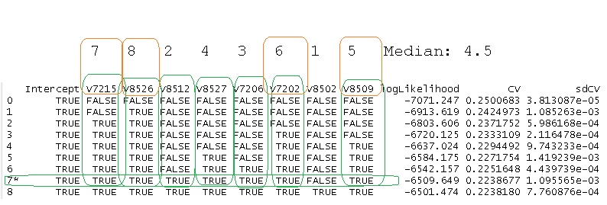
MODIFIED BESTGLM
Used both binary logistic regression and cross validation.
Reduced the list in half, regardless of minimum error.
Results were based on >= median column tabulation of the factors present in the bestGLM list.
The best subset was selected having the smallest number of factors within 1 standard error of minimum k.
Notes:
the modified subset algorithm generally preserves more than what bestglm would normally output and it is this feature that makes it useful for our filtering purposes.

Slide 17
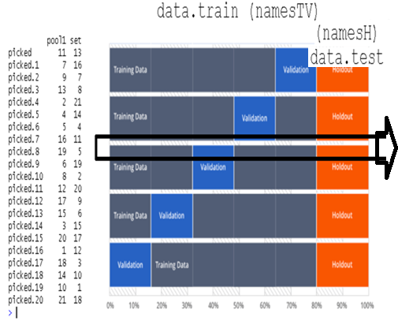
The system is like a moving “football” filtering from training through holdout datasets
Two sets of up to 21 factor pairs (see next slide) are generated
Different numbers are assigned to different elements so that a factor is not paired with itself.
This method minimizes the complexity by reducing the subset problem to 2 pairs at a time and then assigning a cutoff threshold afterwards.
Number of successes are divided by 2 because each factor is paired twice.
Notes:
During NamesH list generation is where we apply holdout analysis. We don’t use traditional concepts like using RMSE and trying to find the best model. Rather we use the concept of having a separate holdout partition to do more testing from.

Slide 18
Model Assumptions of Binary Logistic Regression
Model Assumptions
www.statisticssolutions.com/assumptions-of-logistic-regression/
First, binary logistic regression requires the dependent variable to be binary and ordinal logistic regression requires the dependent variable to be ordinal.
Second, logistic regression requires the observations to be independent of each other. In other words, the observations should not come from repeated measurements or matched data.
Third, logistic regression requires there to be little or no multicollinearity among the independent variables. This means that the independent variables should not be too highly correlated with each other.
Fourth, logistic regression assumes linearity of independent variables and log odds. although this analysis does not require the dependent and independent variables to be related linearly, it requires that the independent variables are linearly related to the log odds.
Notes:
We let CV do the work for us by finding the best model and check collinearity using mcstat VIF during saveCSVs.R

Slide 19
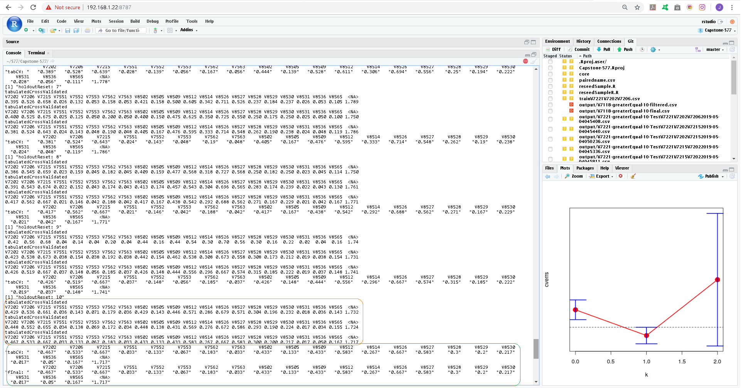
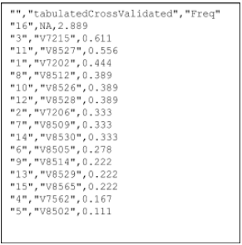
Tabulated Results
10 holdout x 3 resample loops makes for 30 number of runs
Notes:
The right you see two factors squared off with y during a sub_returnCVNames routine.
The figure above details in orange each resample’s 3 tabulated results. There are 10 sets of these 3 resamples. I.e 10 holdout x 3 resample loops makes for 30 number of runs (numRuns) by which the tabulated results are divided against.
At the end of all the holdout passes crossValidated is translated to tabulatedCrossValidated (encircled in green) and a final.csv is printed with the factors occurence stored as “Freq”. Output from V7221’s final.csv is provided.
"","tabulatedCrossValidated","Freq"
"21",NA,3.683
"12","V8514",0.45
"8","V8502",0.417
"17","V8530",0.383
"11","V8512",0.367
"6","V7562",0.333
"19","V8536",0.333
"13","V8526",0.3
"9","V8505",0.267
"10","V8509",0.267
"18","V8531",0.233
"3","V7215",0.217
"2","V7206",0.183
"5","V7552",0.15
"15","V8528",0.15
"1","V7202",0.133
"14","V8527",0.067
"20","V8565",0.067
"4","V7551",0.033
"7","V7563",0.033
"16","V8529",0.017

Slide 20
saveCSVs.R
Model Comparisons
Sorted Frequency of Tabulated Terms
Cutoff threshold
ROC Plots
Classification Matrix
Regression Equations
Subset Filtering via Monte Carlo class balancing
Correlation Matrix

Slide 21
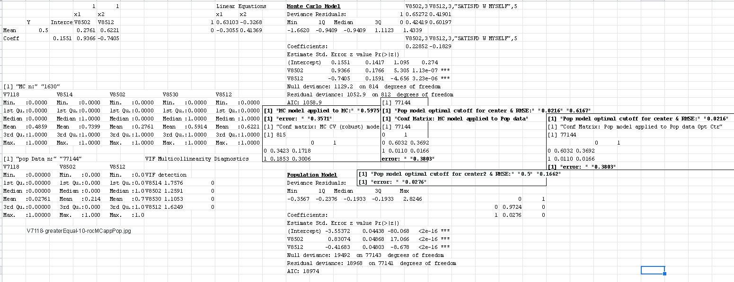
Notes:
50% yes/no Psychedelic Drug User
V8514: 74% Good to be alive
V8502: 27.6%think life is meaningless
V8530: Often 7 Hours sleep 59%
V8512: 62% satisfied with themself
Population
2% gang violence in population
V8502: 21.4%think life is meaningless
V8512: 70% satisfied with themself

Slide 22
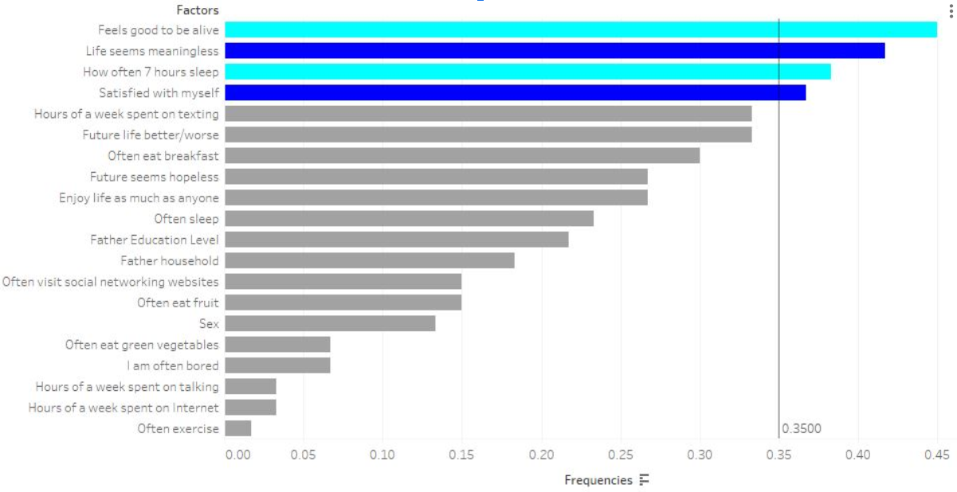
V7221
Psychadelic
Notes:
Note exclusions:
life seems meaningless
sleep were contenders

Slide 23
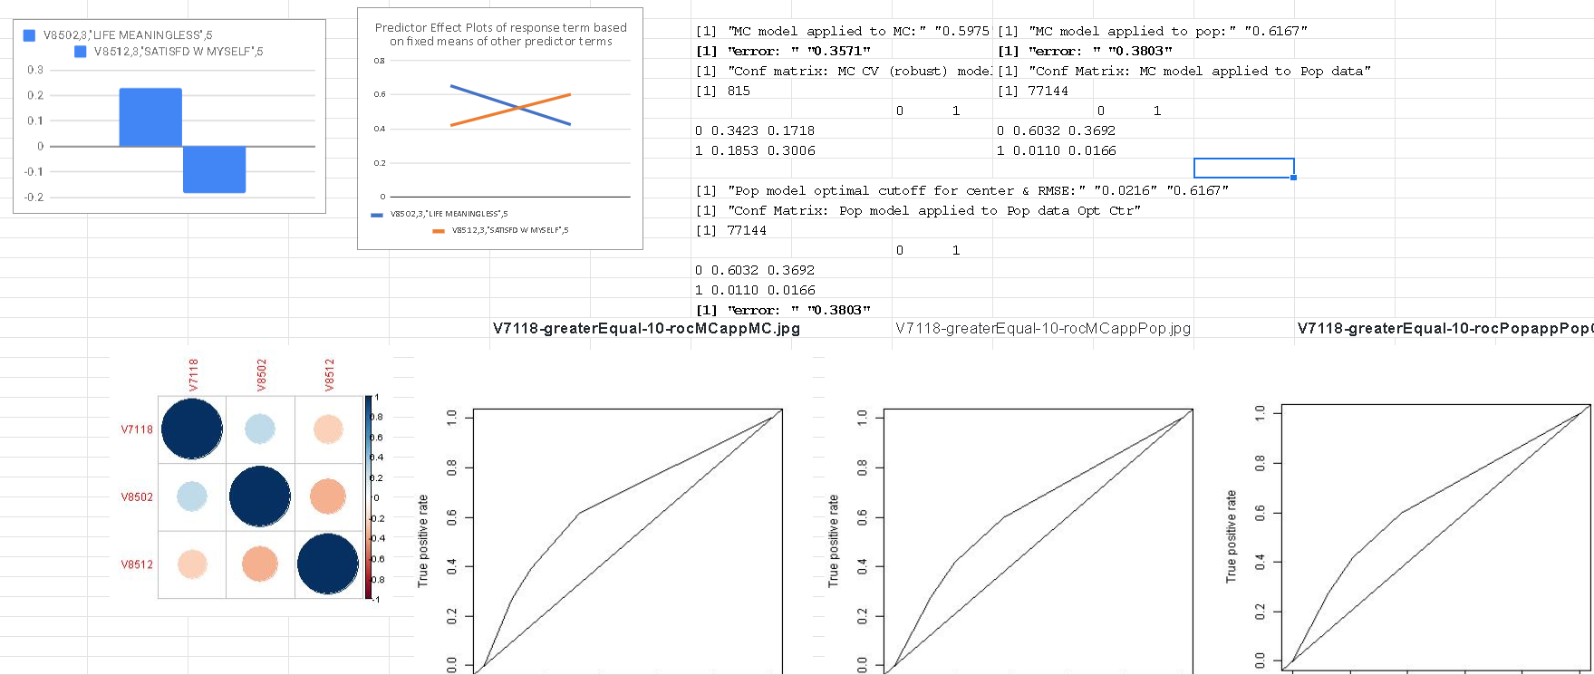
Notes:
our model is better at predicting 1's when the population overfits to 0's (2.16% error rate comes at the cost of predicting no 1’s)
and our model is as good as the population model is at optimal threshold
V7118 Psychedelic Drug Use, presence of:
V8502: “Life is meaningless response” +~21%.
V8512: “Satisfied with myself” -~19%
Error Rate: 38.03%

Slide 24
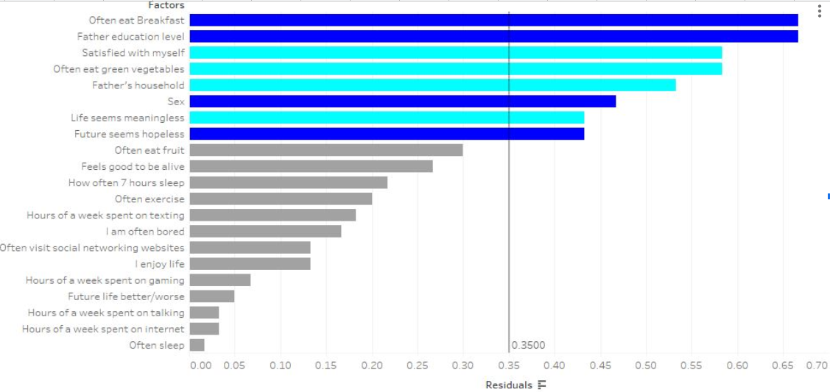
V7221
GPA
Notes:
Note exclusions:
often eat breakfast
father education level
gender
future seems hopeless

Slide 25
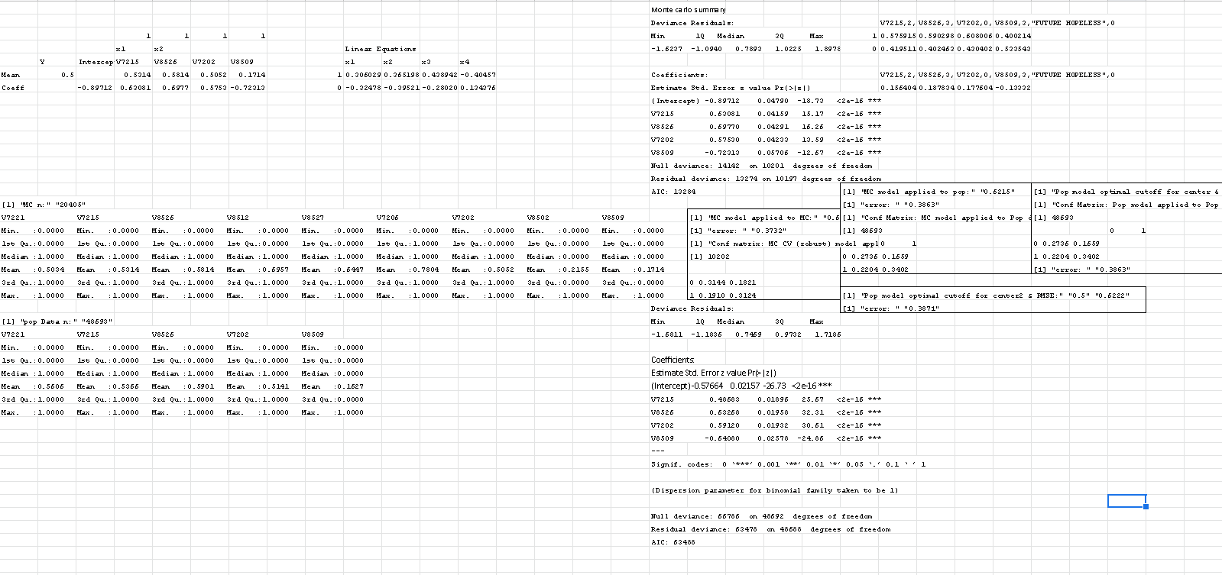
Notes:
our model is better at predicting 1's when the population overfits to 0's (2.16% error rate comes at the cost of predicting no 1’s)
and our model is as good as the population model is at optimal threshold
but our error rate is the same as the population overfitted model when adjusted for cutoff. Telling us we have the optimal model.

Slide 26
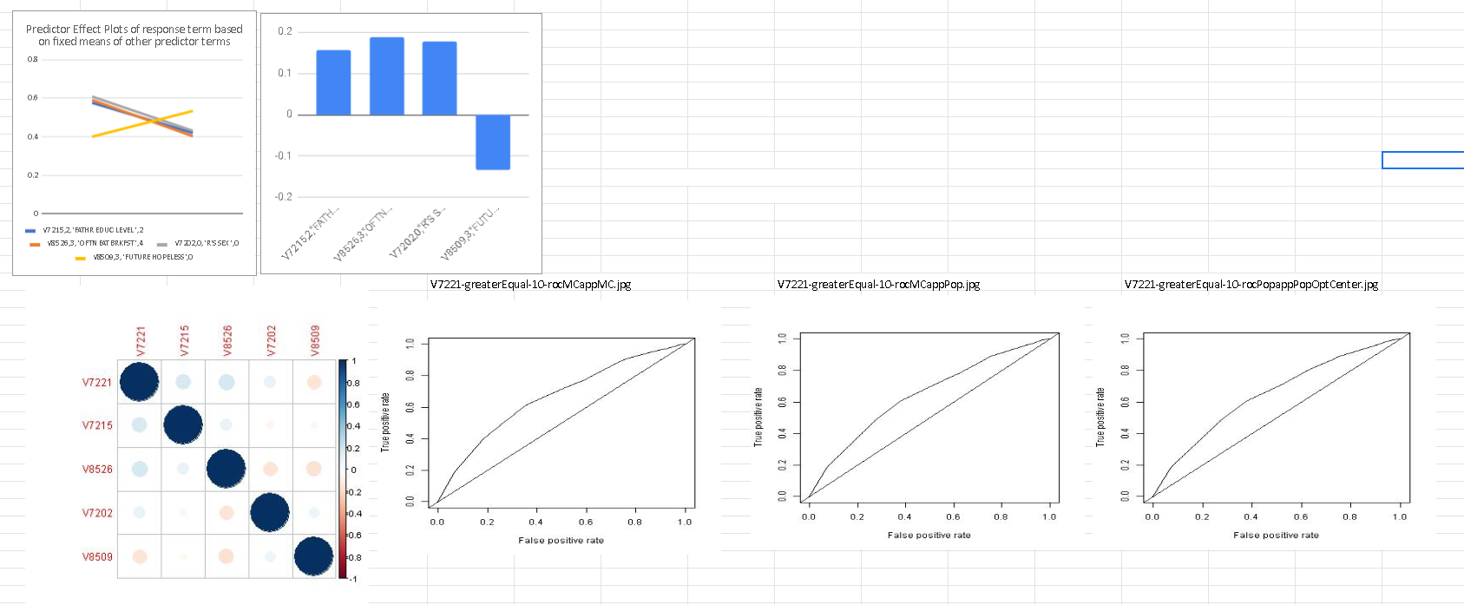
Notes:
V7221 GPA (B+)
Father’s Education Level +~15%
Often eating breakfast +~19%
Being a woman +~18%.
View the future as hopeless ~-13%.

Slide 27
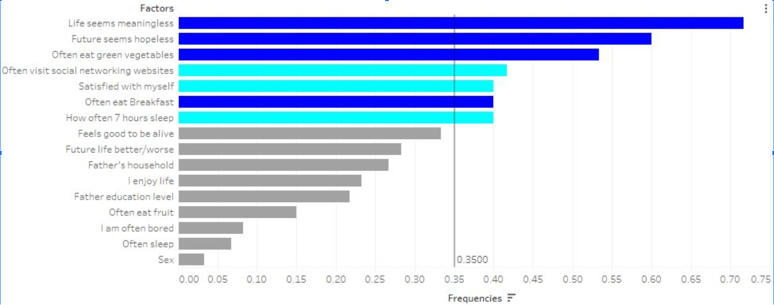
V8517
Gang Violence
Notes:
Note exclusions:
Often visit networking websites
Satisfied with myself
How often 7 hours sleep

Slide 28
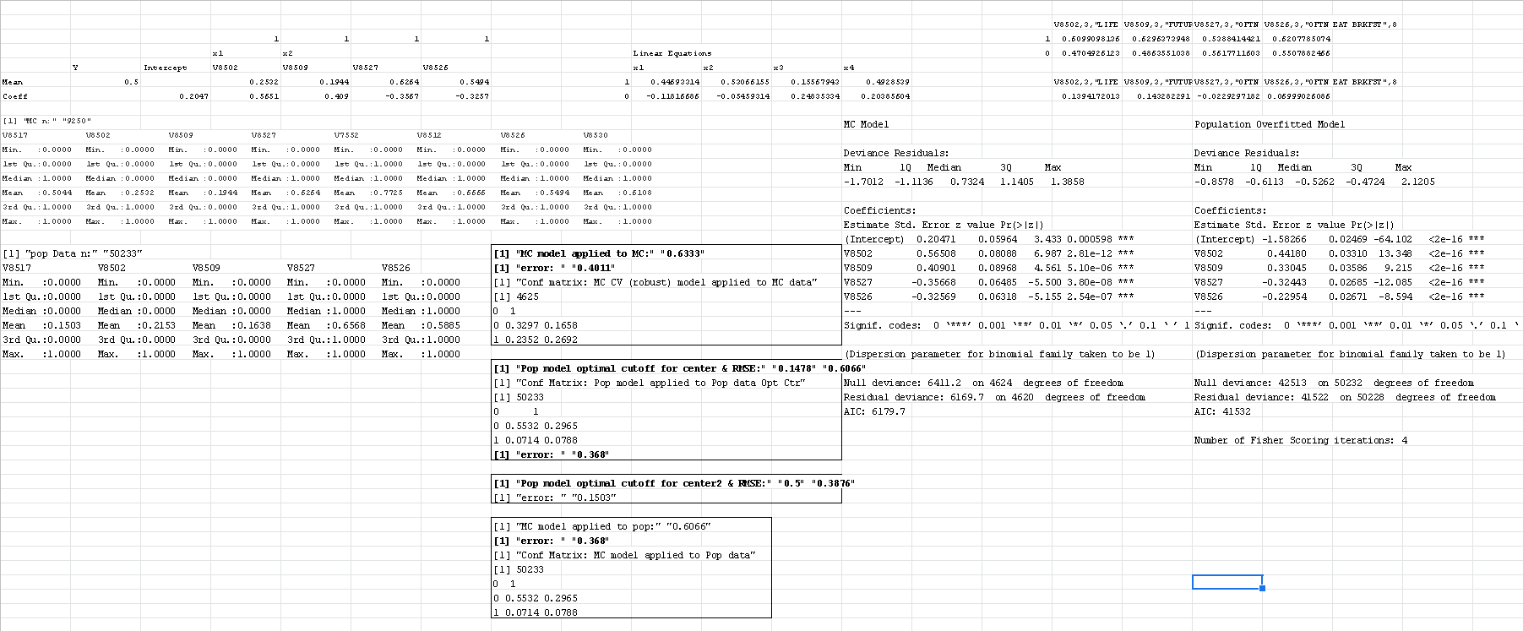
Notes:
15% gang violence in population
this model has the same issue as V7118, overfitting (15% error rate, but never classifies any 1’s). Yet our model converges on it’s optimized error rate.

Slide 29
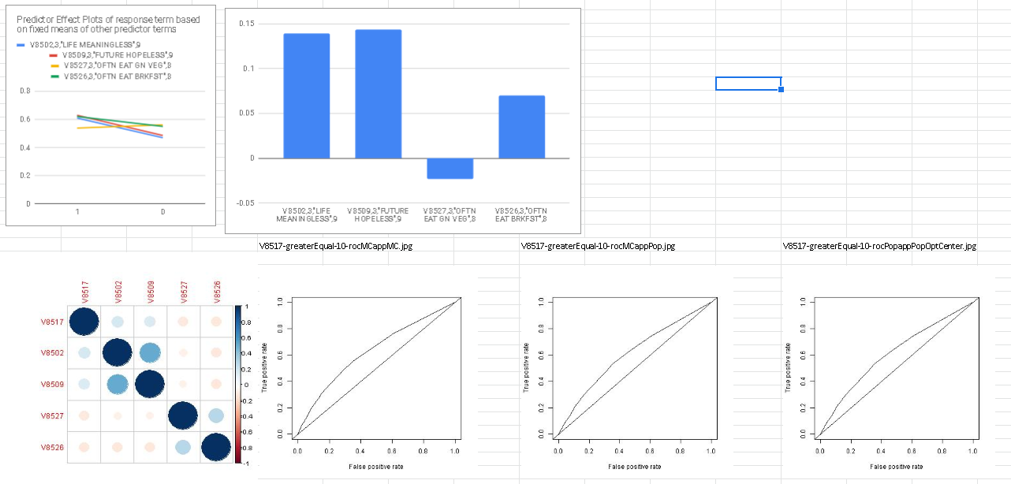
Notes:
V8502: Life Meaningless: ~14% increase
V8509: Future Hopeless: ~ 14% increase
V8527: Often Eat Green Vegetables: ~2.5% Decrease
V8526: Often Eat Breakfast: 7.5% Increase

Slide 30
CONCLUSION
V7118=exp(0.1551+0.9366*V8502-0.7405*V8512)/1+exp(0.1551+0.9366*V8502-0.7405*V8512)
V7221=exp(-0.8971+0.6308*V7215+0.6977*V8526+0.5753*V7202-0.7231*V8509)/1+exp(-0.8971+0.6308*V7215+0.6977*V8526+0.5753*V7202-0.7231*V8509)
V8517=exp(0.2047+0.5651*V8502+0.4090*V8509-0.3567*V8527-0.3257*V8526)/1+exp(0.2047+0.5651*V8502+0.4090*V8509-0.3567*V8527-0.3257*V8526)
These formulas derived from best glm gives the relationship between different factors.

Slide 31
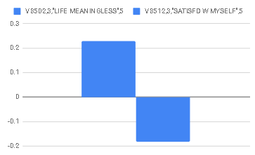
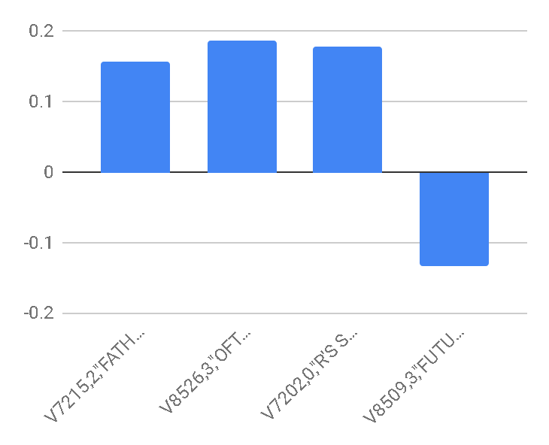
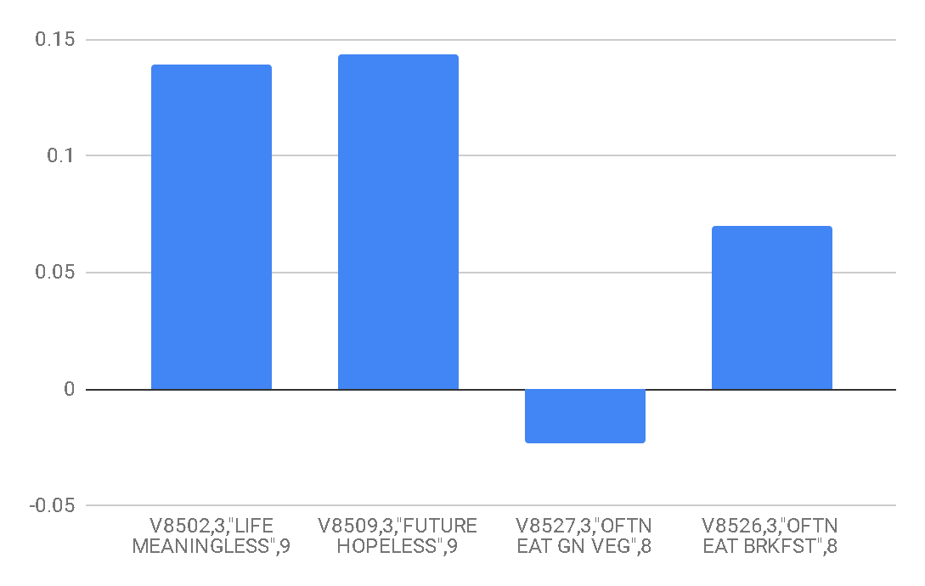
Inferences
V7221 GPA (B+) Inclusion
38.6% error Rate
V8517 Gang Violence
36.8% error Rate
V7118 Psychedelic Drug Use
38.03% error Rate

Slide 32
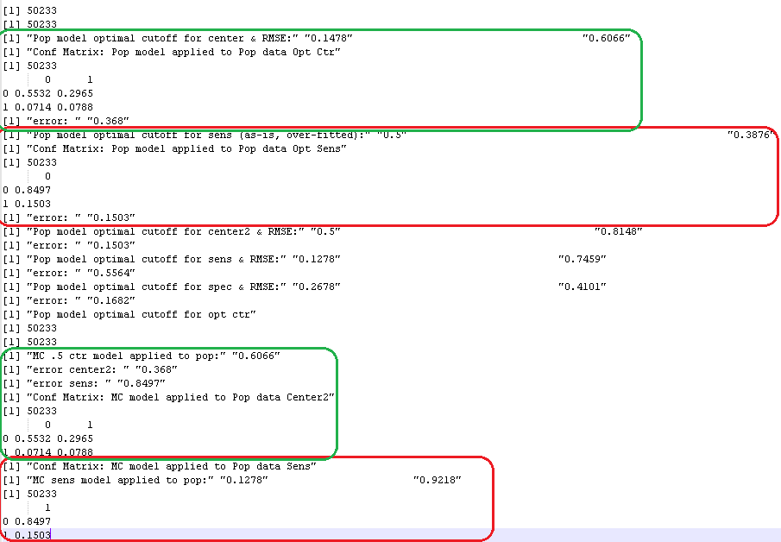
When we adjusted the population overfitted model’s plogis output for optimal sensitivity and “both” thresholds respectively, our monte carlo class balanced model converged on the same confusion matrix error rates as the population overfitted model.
Tells us these thresholds hold for the population [and can be used in the future to achieve similar accuracy results].

